Slide 1
PKI setup

Slide 2
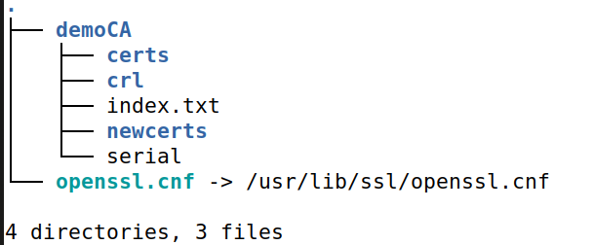
Set UP Openssl.conf in VM.
sudo apt update
sudo apt install build-essential check install zlib1g-dev –y
cd /usr/local/src/
wget https://www.openssl.org/source/openssl-1.0.2o.tar.gz
tar -xf openssl-1.0.2o.tar.gz
cd openssl-1.0.2o
https://www.howtoforge.com/tutorial/how-to-install-openssl-from-source-on-linux/
sudo apt-get install libssl-dev
sudo apt-get install bless
mkdir PKI
cd PKI
mkdir demoCA
ln -s /usr/lib/ssl/openssl.cnf openssl.cnf
cd demoCA/
mkdir certs
mkdir crl
touch index.txt
mkdir newcerts
echo "1234" > serial
cd ..

Slide 3
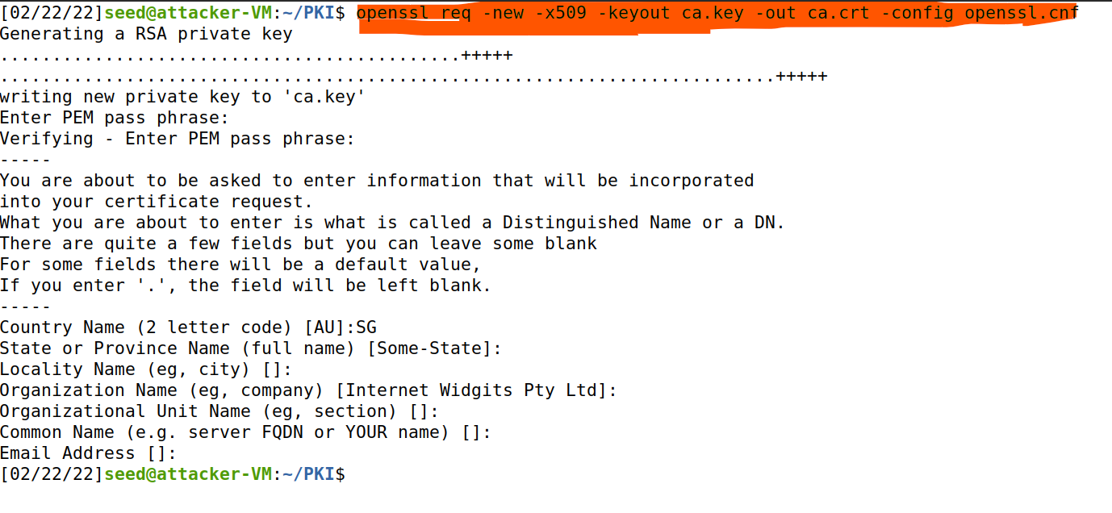
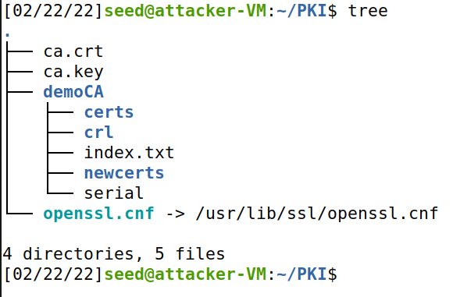
How to create a self certificate.

Slide 4
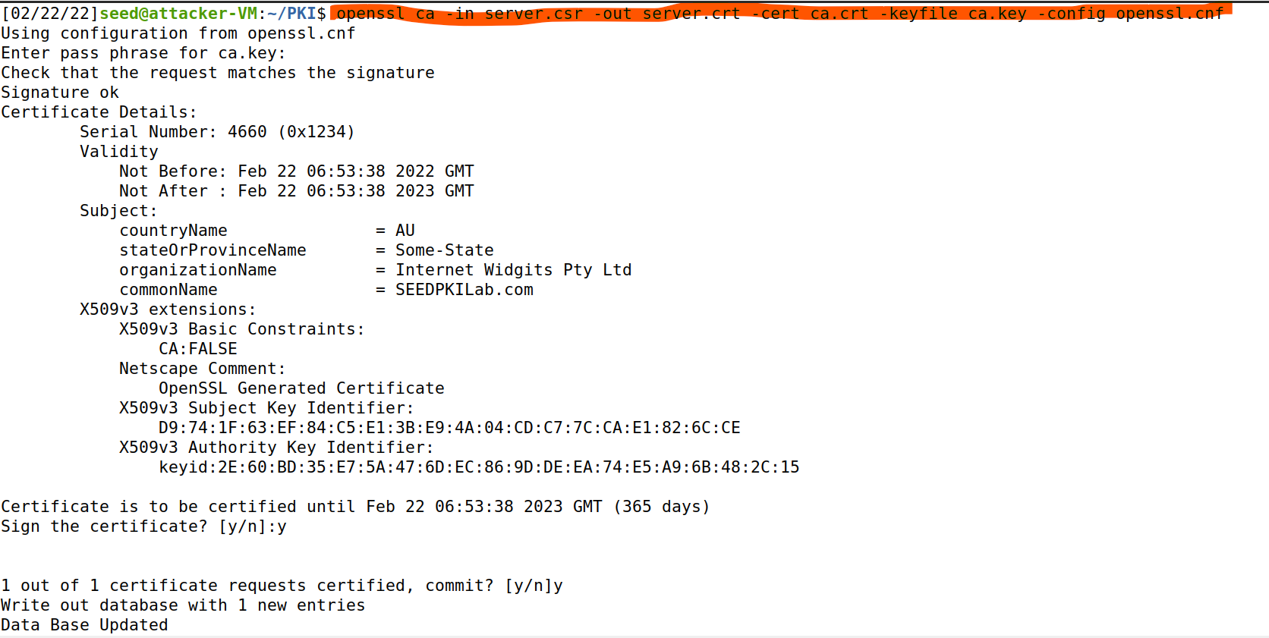
Generating Certificates

Slide 5
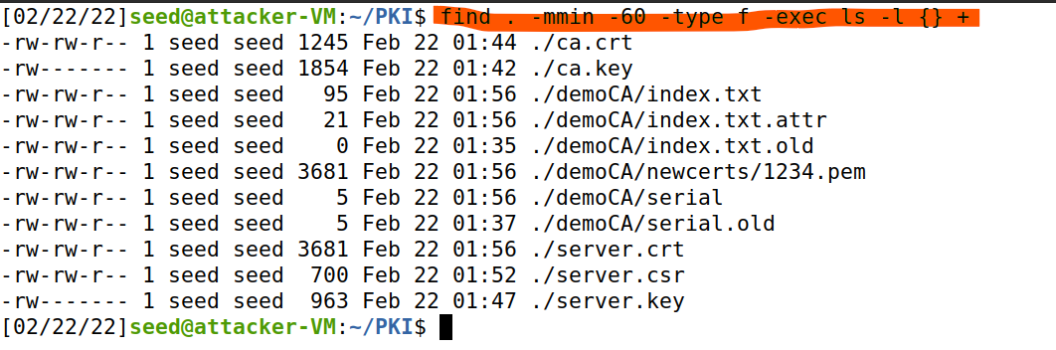
Files created in the last 60 minutes.

Slide 6
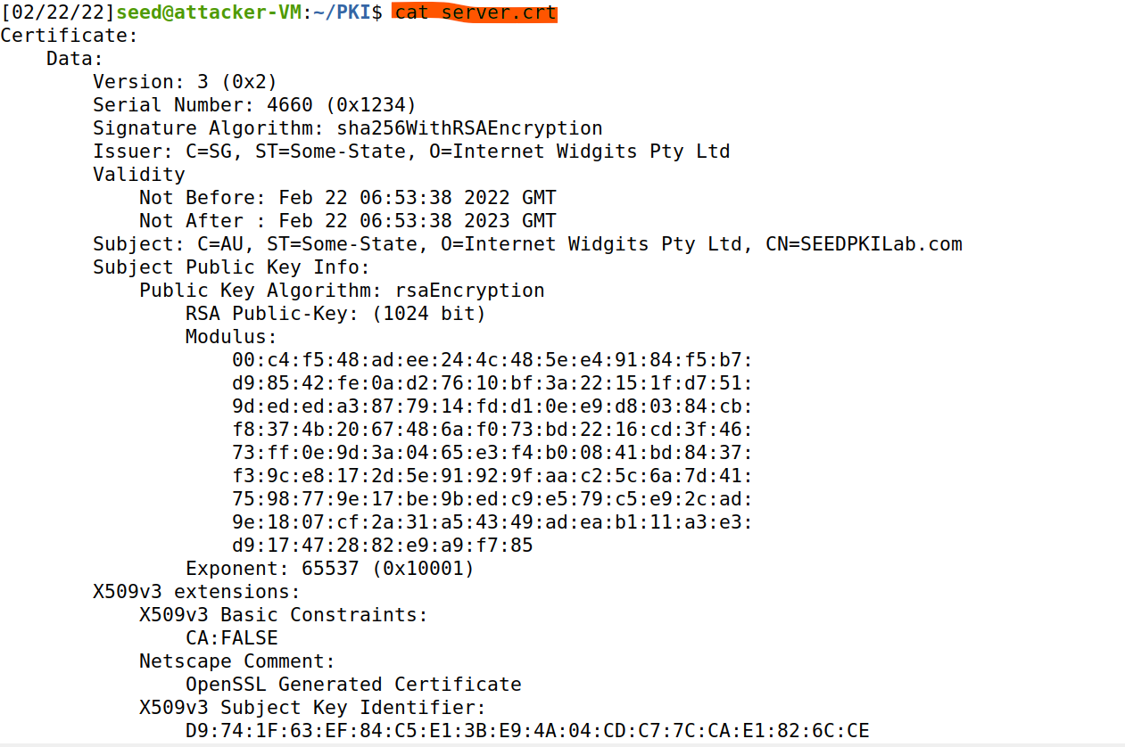
Viewing the certificate

Slide 7
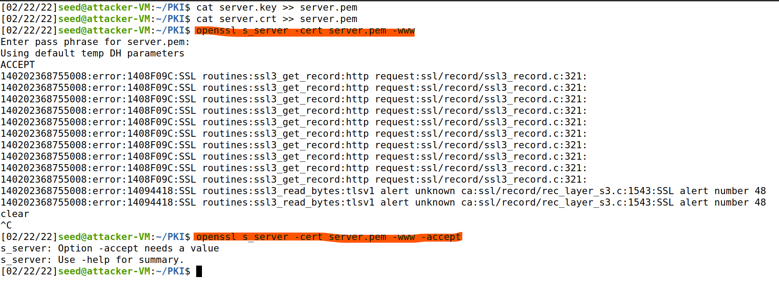
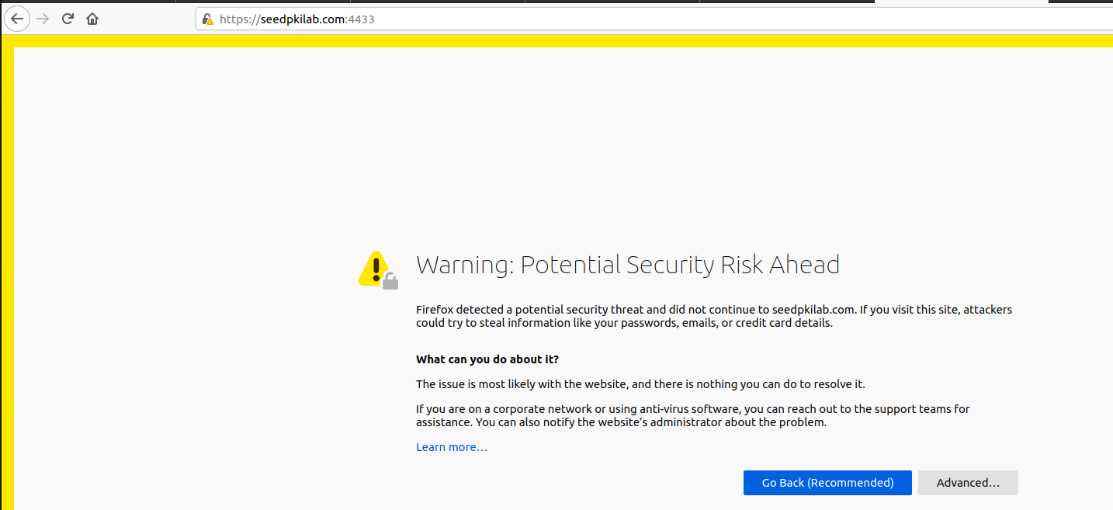
Configuring the web server
sudo reboot

Slide 8
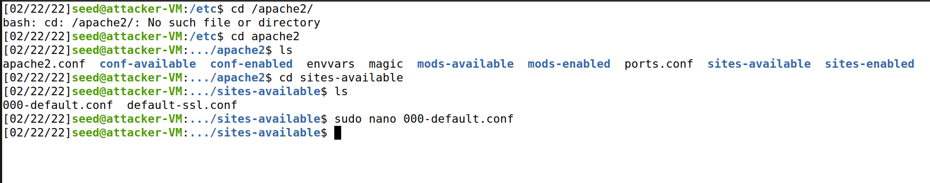
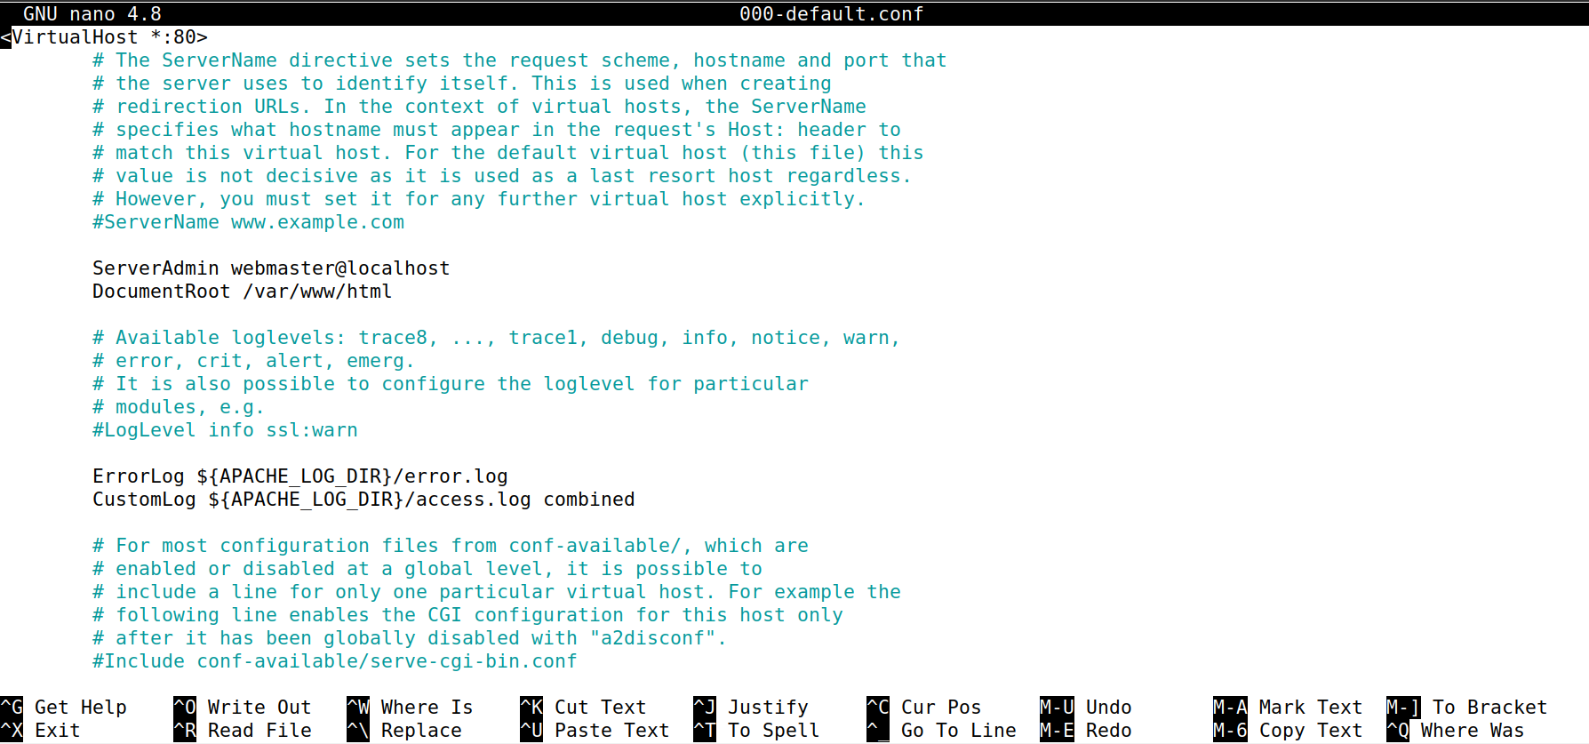
Apache 2 installation.
sudo apt update
sudo apt install apache2
https://www.digitalocean.com/community/tutorials/how-to-install-the-apache-web-server-on-ubuntu-20-04

